Slide 1
Grundlagen Englisch
modal verbs
HFW Bern
Philipp Brunner

Slide 2
modal verbs (1)
modal verbs = auxiliary verbs used with a main verb
Modal verbs change the meaning of the main verb (modality).
Two modal verbs cannot go together.
Modal verbs are not conjugated!
use: modal verb + infinitive
→ Let‘s look at some examples:

Slide 3
modal verbs (1)
may: May I go to the toilet?
might: I‘m late. I might miss the train.
can: Can I have a day off next week?
allowed to: You‘re not allowed to be in here.
(un)able to: He‘s (un)able to walk.
could: Could you tell me the time, please?
would: Would you please inform your boss?

Slide 4
modal verbs (2)
will: I will take that bag for you. (tense)
going to: I‘m going to buy a new car, soon. (tense)
shall: Shall we offer a discount on this product?
should: We should lower the entry fee.
have to: You have to stop at a red traffic light.
must: I must go now. I need some sleep.

Slide 5
modal verbs (3)
use: modal + infinitive
functions:
intentions: will, might, could, also: going to
permission: may, can, could, also: allowed to
ability: can, could, also: able to
spontaneous offers: will, can, shall
suggestions: should, could, shall
requests: can, could, would, may
obligation: must, should, also: have to
probability: should, would
possibility: may, might, can, could

Slide 6
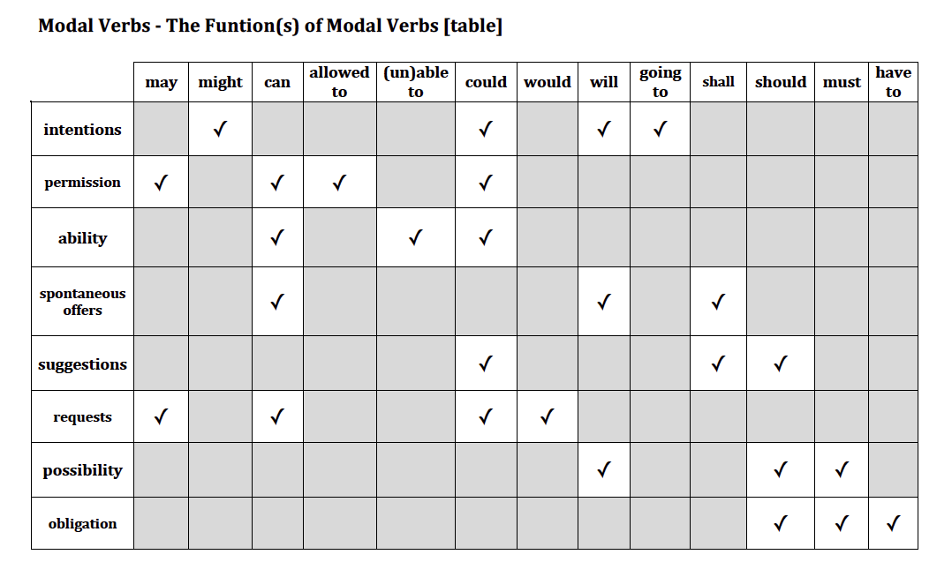
modal verbs (4)

Slide 7
your turn!!
Work on
Grammar Book: Units 23-26, p54-61
Murphy Copies

Slide 8
Summary
present simple & continuous
past simple & continuous
nouns, articles and determiners
adjectives & adverbs
comparison of adjectives & adverbs
perfect tenses
future tenses
relative clauses
modal verbs

